Slide 1
Ames Housing Data
ML Learning Project
Asaad Al Busaidi
Al Mutasim Bakathir Al Kindi

Slide 2
01
Introduction
Agenda
The Project outline , the data and the targeted output.
02
The Method
The EDA part of the project
03
Findings
The insight and observation found out of the dataset.
04
The Modeling
The ML learning part of the project with all different models used and comparisons .
05
Future work
The future enhancements to the project

Slide 3
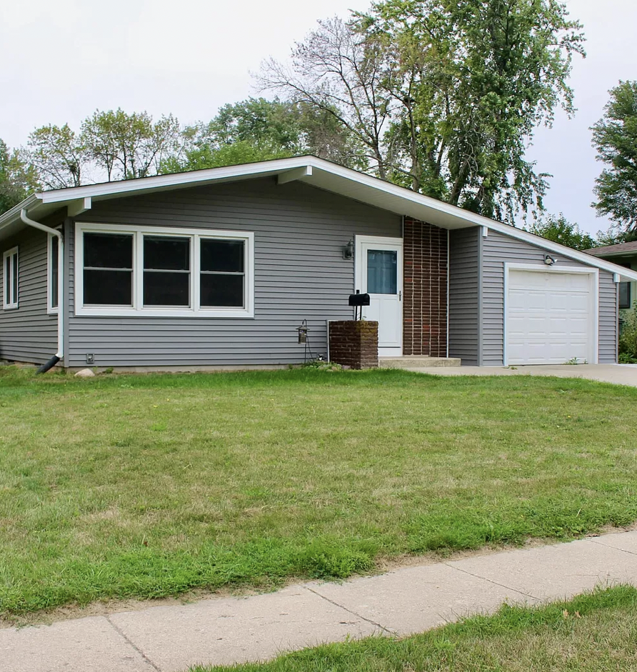
Introduction
Background :
Ames, Iowa is the college town of Iowa State University. The Ames housing dataset consists of about 25 Million house sale records between 2006−20102006−2010. which includes Detailed information about the house attributes and their Prices.
The Aim of the project :
Perform descriptive data analysis to gain business insights.
Build descriptive machine learning models to understand the local housing market.
Build predictive machine learning models for the local house price prediction.
Image from Zillow.com

Slide 4
Who We Are ?
We Represents
We are data scientists for an online real estate database company which provides house price estimation for the site visitors.
Target Group :
Any personal or public individuals/company that seeks housing markets insights and predictions.

Slide 5
The Method
Exploring the Data
Cleaning and Tuning
Visualizing
Modeling
Importing the data
Exploring the dataset
Describing the data and understanding the different features types.
Checking the Null values and trying to fill them with the appropriate values.
Deleting un-used columns and duplicates.
Normalizing the data and renaming the features to give them a clear meaning.
Plotting and visualizing the data features to find correlations.
Comparing different features to price and observing for outliers .
Learning more about customers behavior over time .
Choosing the features to implement based on correlation tests and scores.
Modeling the data features using different ML Models : Linear Regression , Decision Trees , Lasso , Ridge and Gradient Booster .
Compare different models accuracy and predict the best.

Slide 6
Findings
& Results

Slide 7
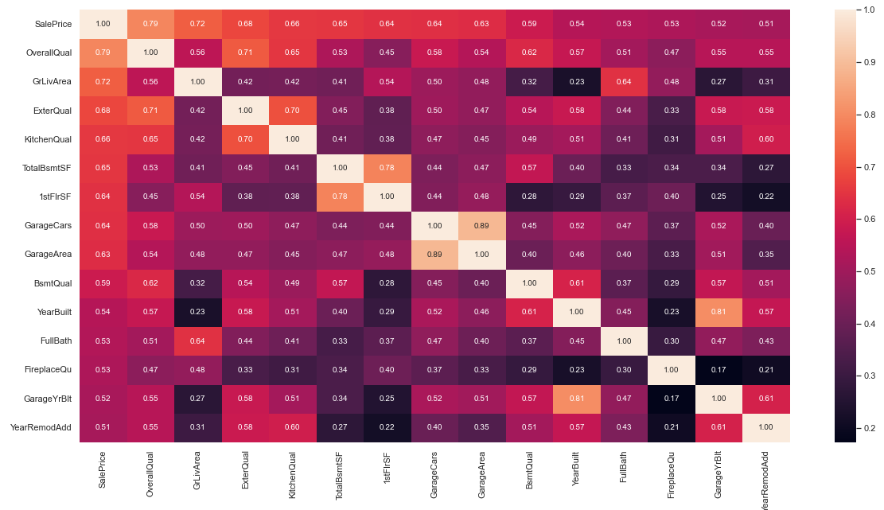
Features Correlation To Price
the following features have higher correlation score with the sales column (above 0.5) :
OverallQual- GrLivArea- ExterQual- KitchenQual- TotalBsmtSF - 1stFlrSF- GarageCars- GarageArea - BsmtQual- YearBuilt- FullBath- FireplaceQu - GarageYrBlt- YearRemodAdd

Slide 8
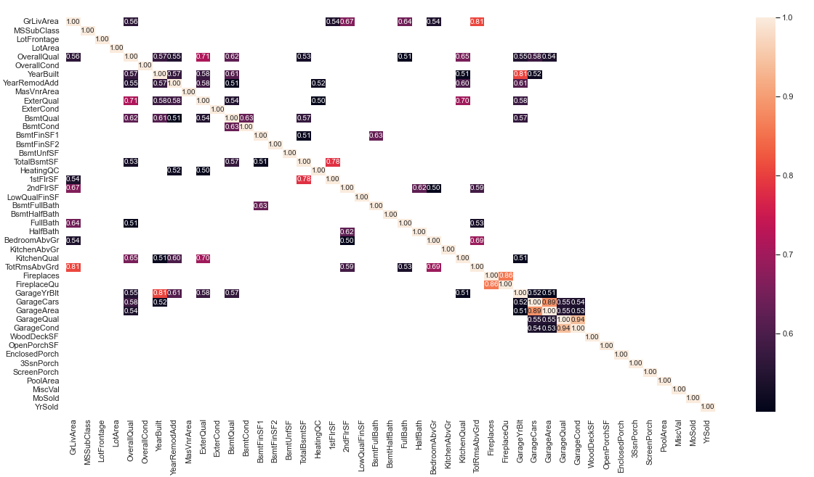
Features Correlation To each other
From the above correlation heat map we can clearly notice the following features having high correlation between each other :
- GarageCars and GarageArea
- GarageYrBlt and YearBuil
- 1stFlrSF and TotalBsmtSF
- GrLivArea and TotRmsAbvGrd

Slide 9
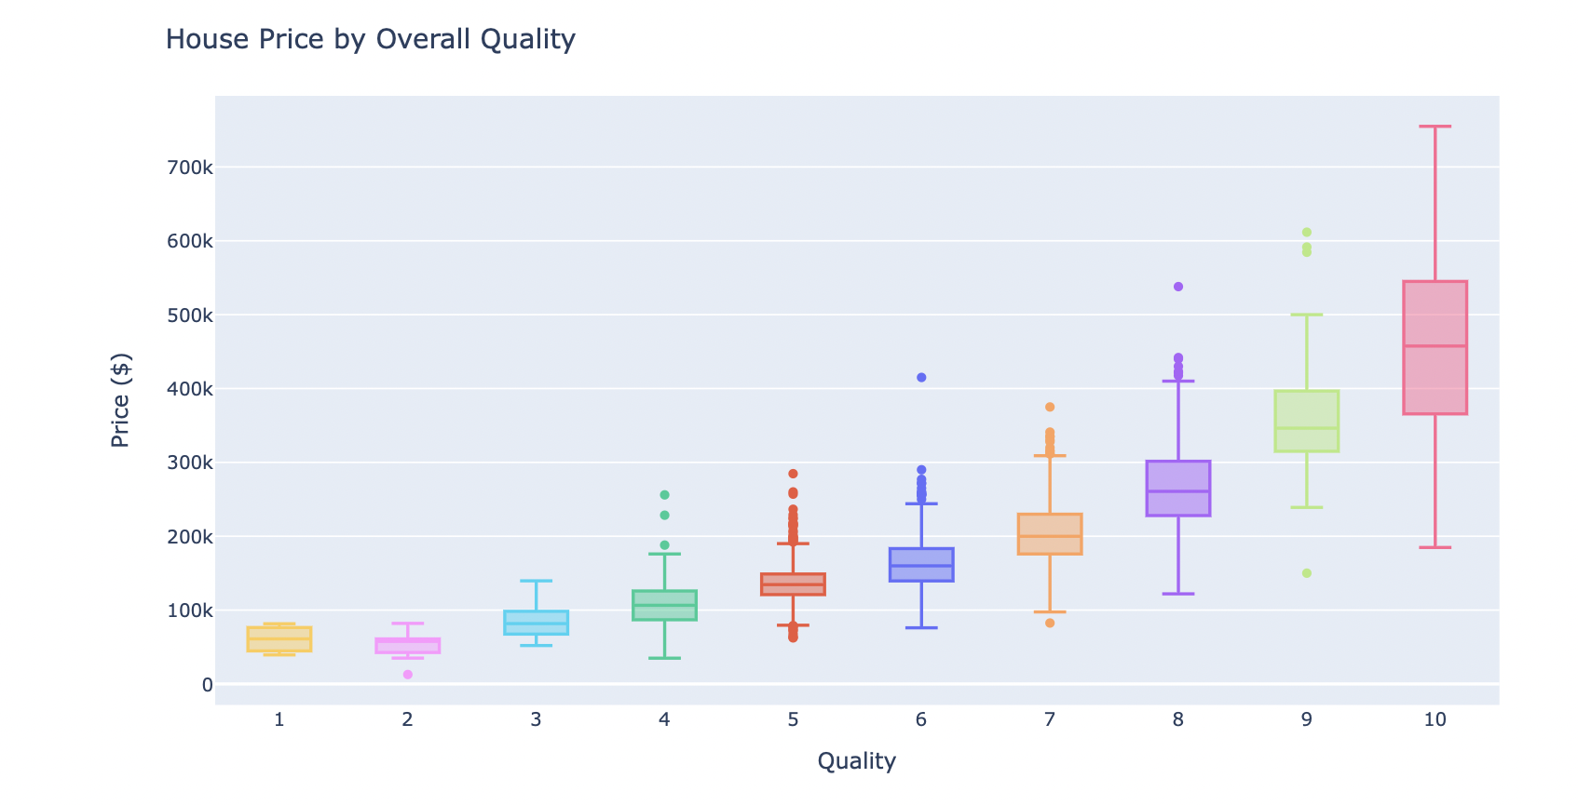
Housing Price to Over all Quality
The housing Price increases as Quality increases in general

Slide 10
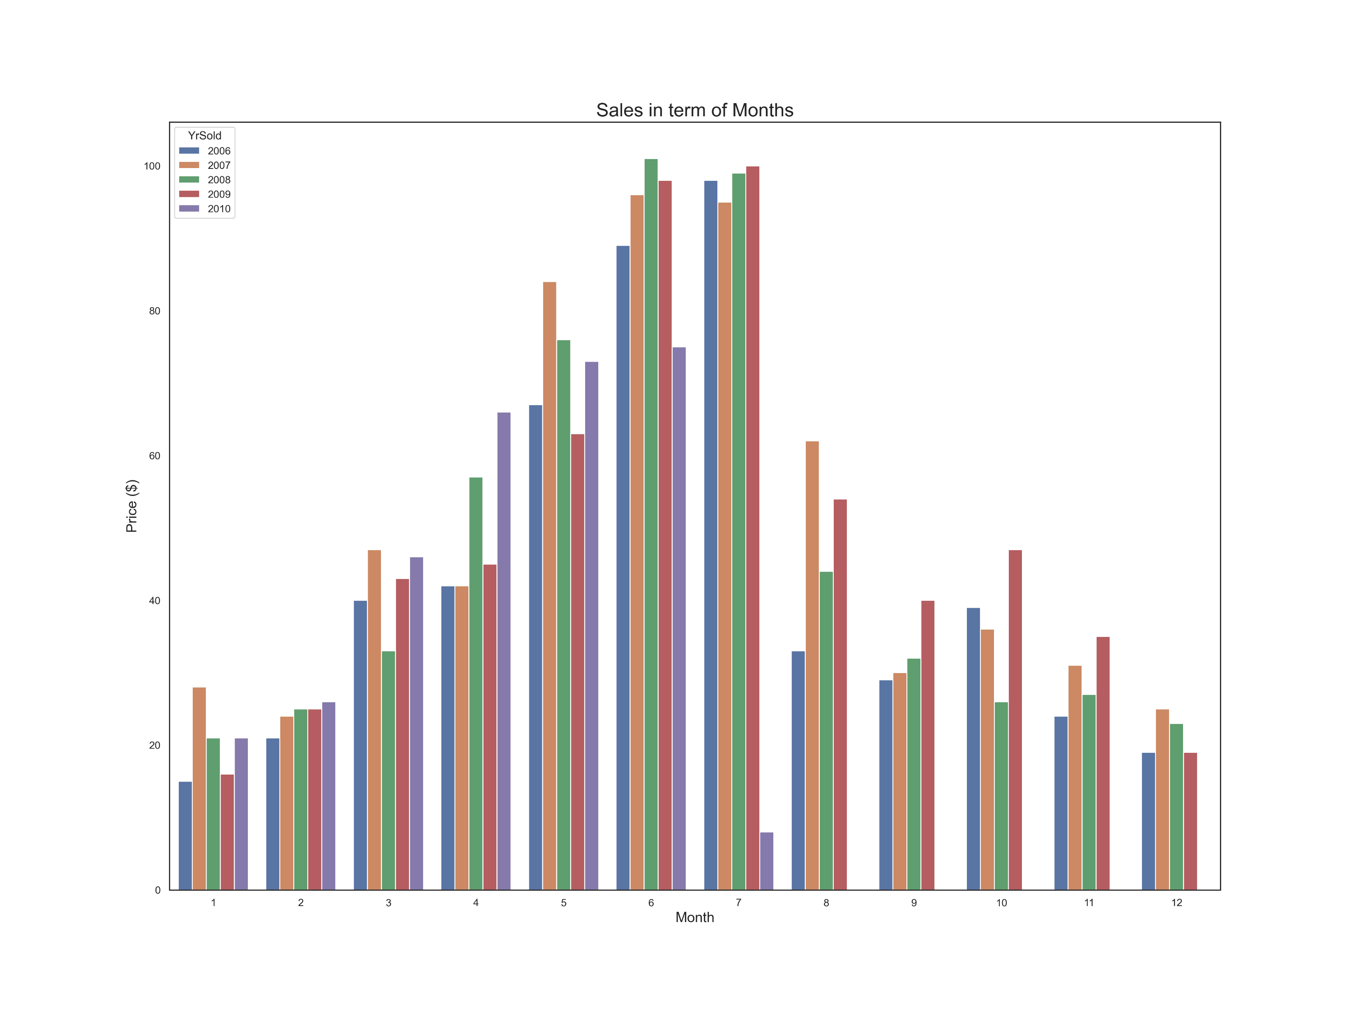
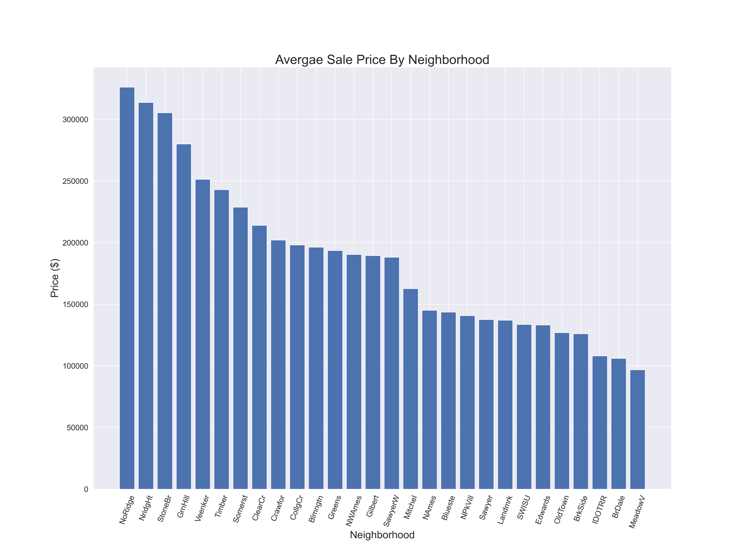
Results and Findings list
People tend to buy more houses during the second quarter of the year ( May-August ) . There also might be some correlation to Temperature degrees and School off period.
Average Sale Price and Neighborhood tend to be correlated .

Slide 11
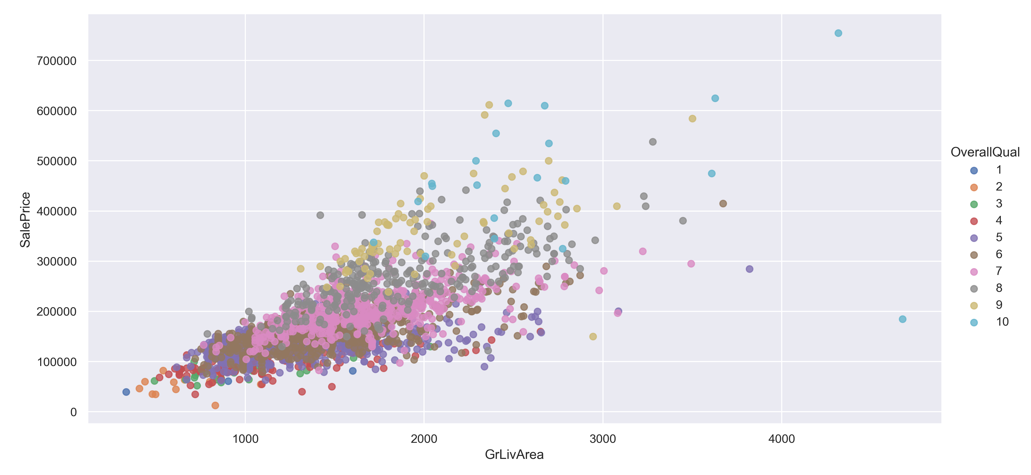
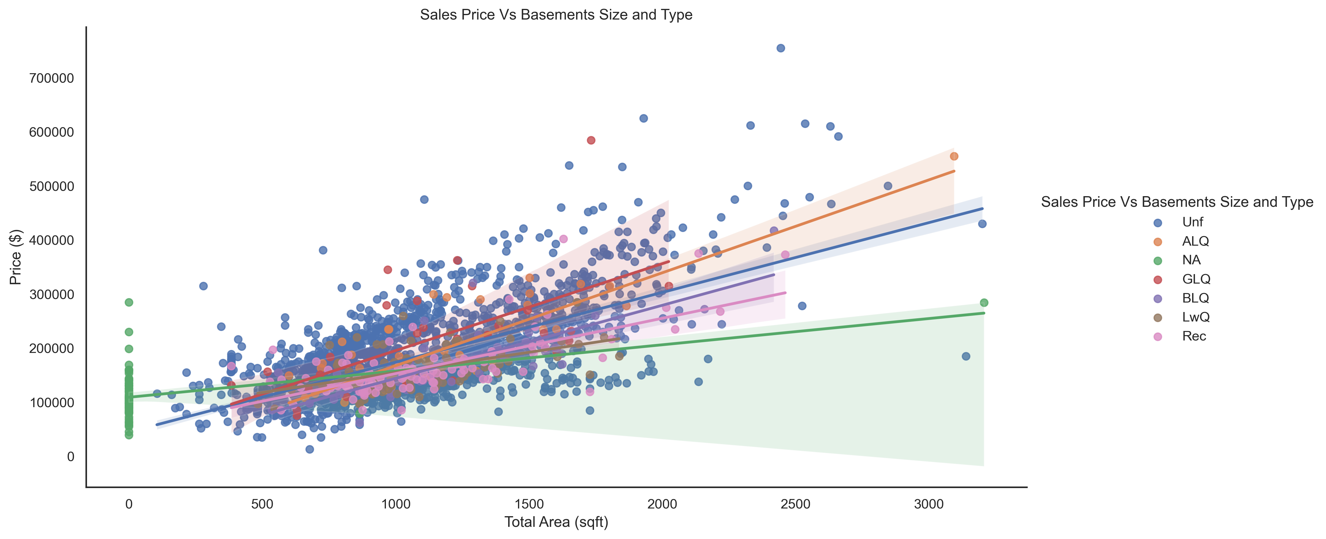
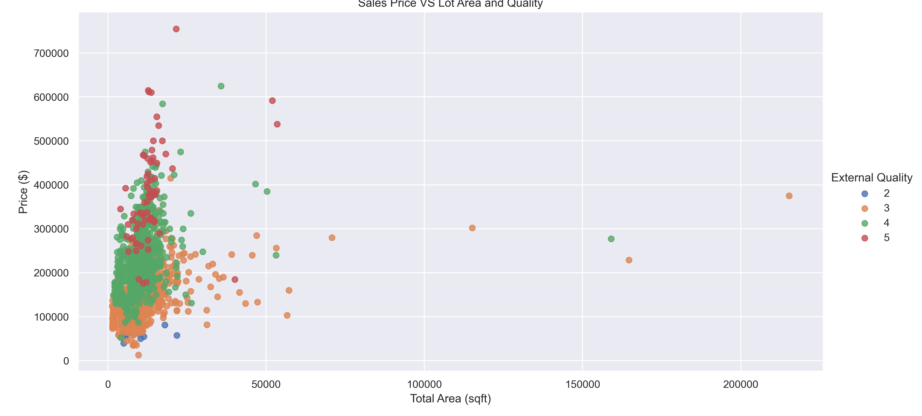
Results and Findings list
Add Text
Simple PowerPoint Presentation
The sale price increase as the ground area increases. Also, the overall quality shows the quality of the materials used in the construction of the house has a direct relationship with the price.
Sale Price and Total square feet of basement area. As the basement area increase the sale price increases. and for areas above 2000 sqrft the BLQ type is to dominant in term of sales.
Lot size in square feet does not affect the price of the house, I general most houses have small land areas .On the Opposite the external quality affects the price directly.

Slide 12
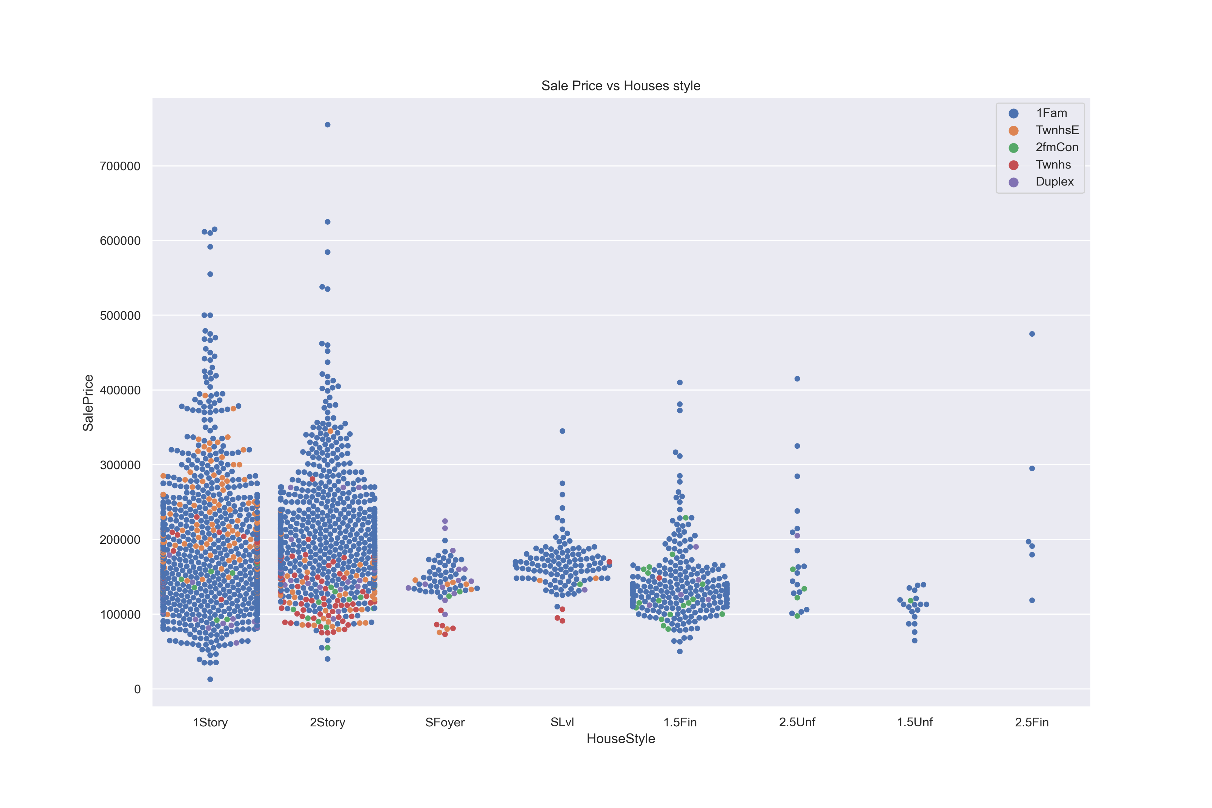
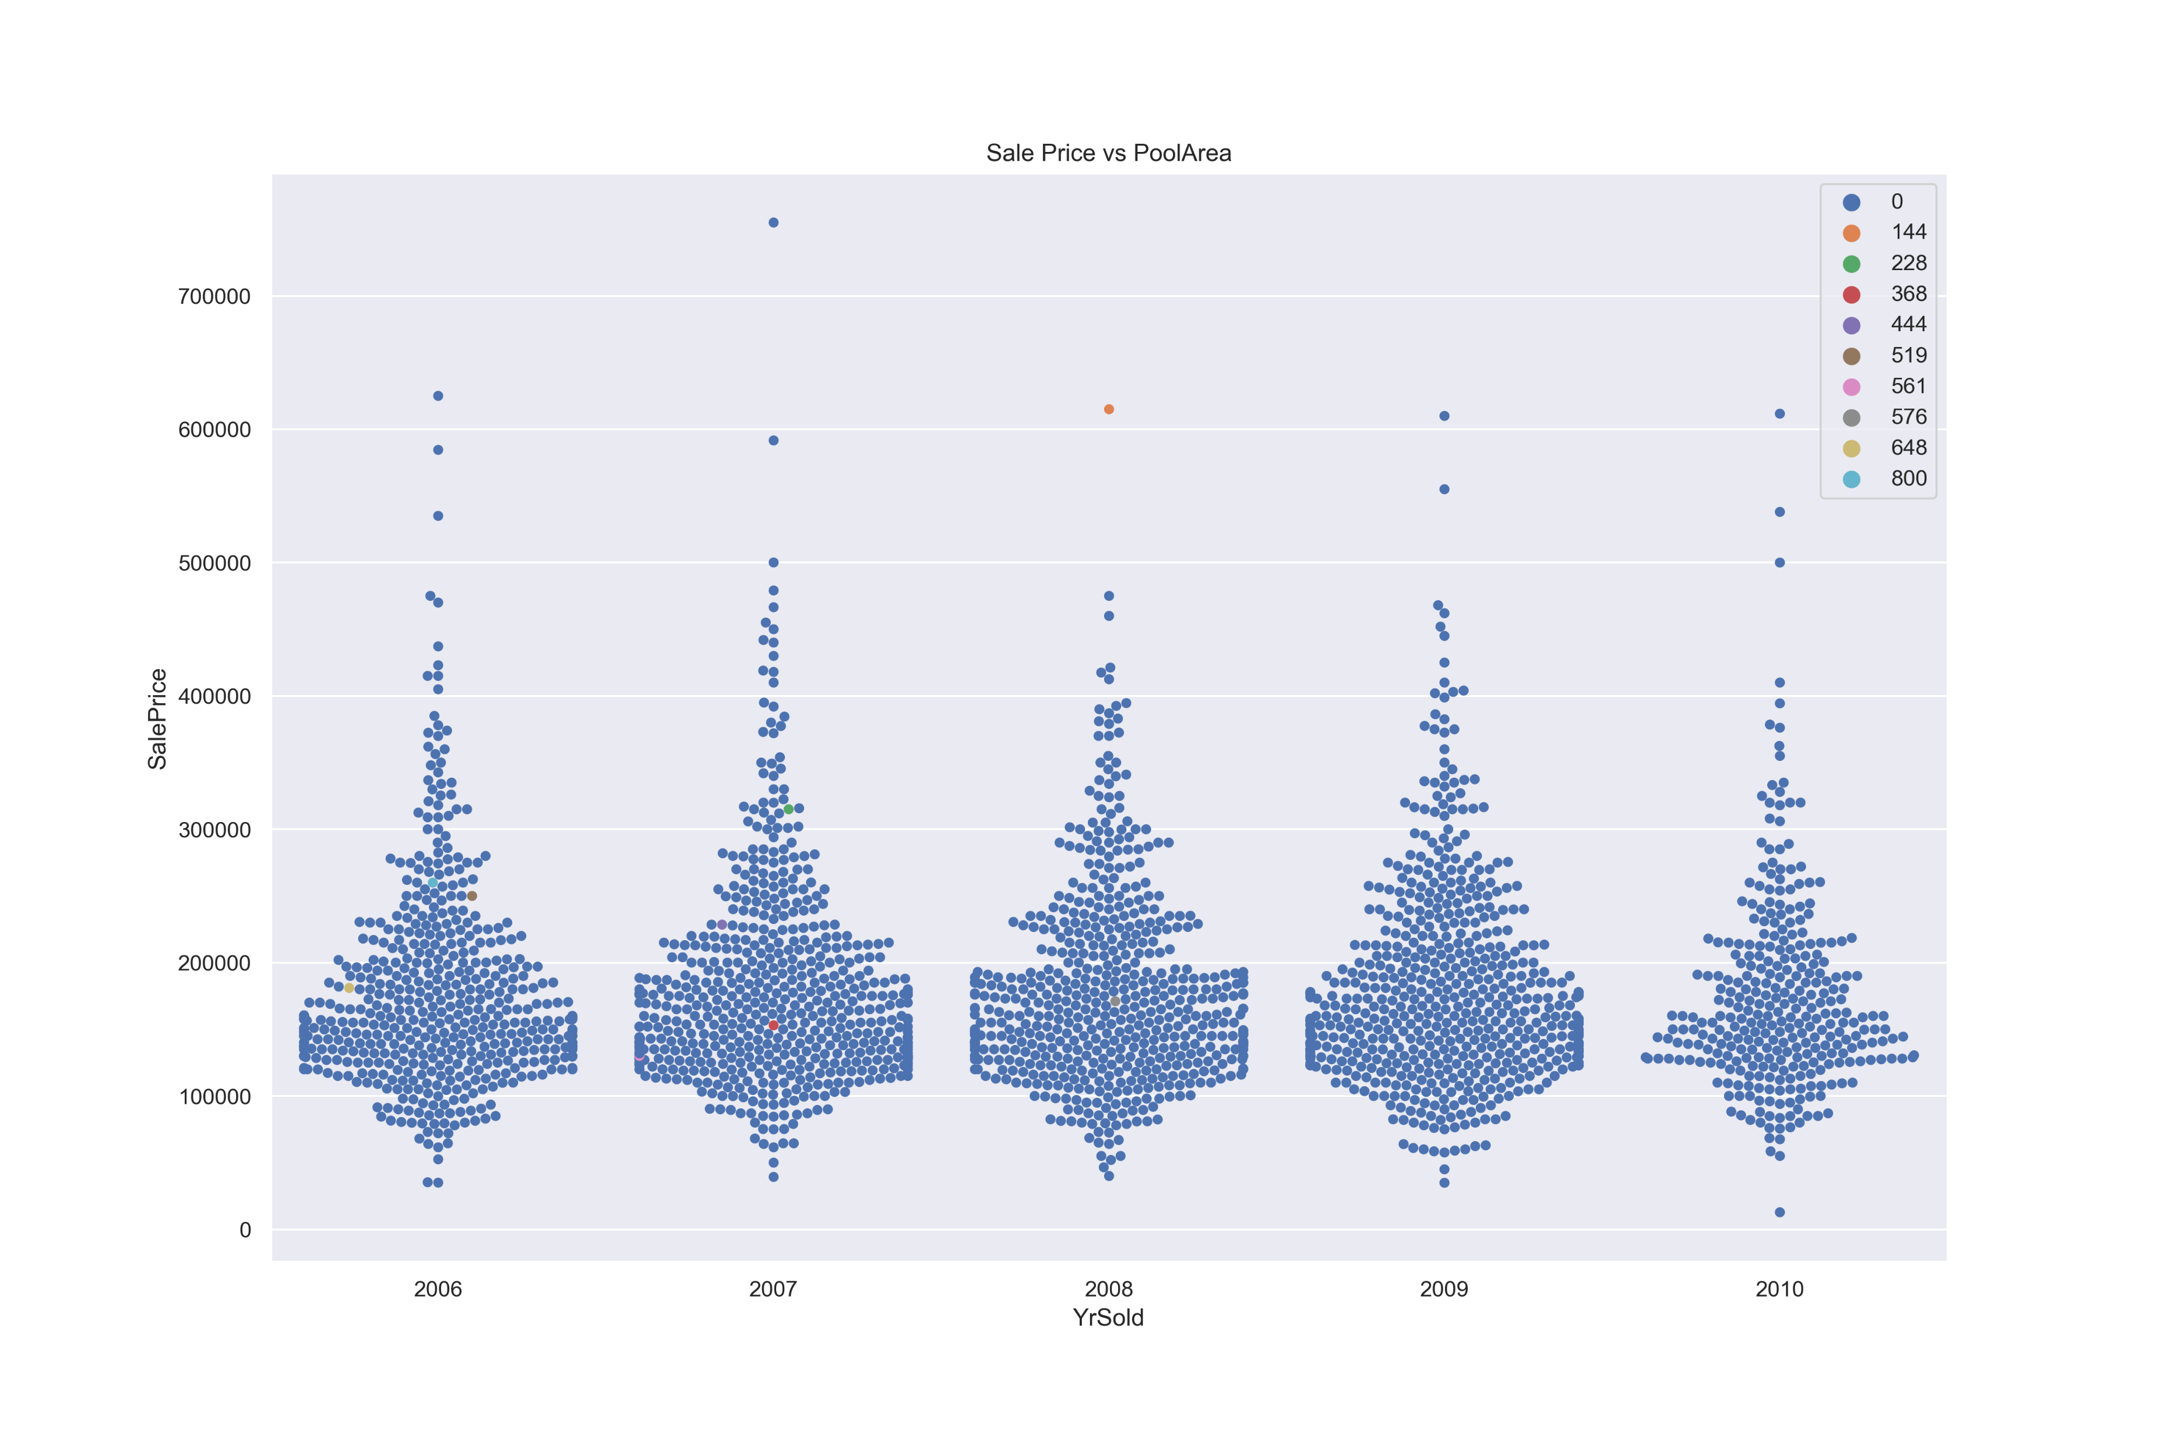
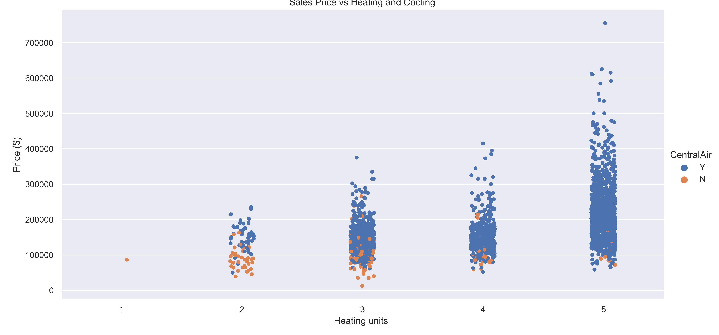
Results and Findings list
The majority of buyers buy one-story or two-story homes with one family building type.
Buyers are not interested in whether the house has a swimming pool or not, and this is evident through the years of sale.
Customers tend to buy house with more Heating and Central Cooling houses/units.

Slide 13
Results and Findings list
Data set has Categoric and numerical values that are correlated to prices .
The housing Price increases as Quality increases in general .
People tend to buy more houses during the second quarter of the year ( May-August ) . There also might be some correlation to Temperature degrees and School off period.
Sale Price and Total square feet of basement area. As the basement area increase the sale price increases. and for areas above 2000 sqft the BLQ type is to dominant in term of sales.
The sale price increase as the ground area increases. Also, the overall quality shows the quality of the materials used in the construction of the house has a direct relationship with the price.
Newer house are more likely to have higher sale prices .
Lot size in square feet does not affect the price of the house, I general most houses have small land areas .On the Opposite the external quality affects the price directly.
Garage Area affect the house price . but in term of Quality , most sales are concentrated within moderate garage quality not the higher ones .
Customers tend to buy house with more Heating and Central Cooling houses/units.
The number of rooms does not affect the price that much .
Buyers are not interested in whether the house has a swimming pool or not, and this is evident through the years of sale.
The majority of buyers buy one-story or two-story homes with one family building type.

Slide 14
The Modeling
All Features Approach
Partial Features Approach
We used all features + some new derived Features
We chose the top 15 features that are correlated with sales prices .
YrBltAndRemod = YearBuilt + YearRemodAdd
TotalSF = TotalBsmtSF + 1stFlrSF + 2ndFlrSF
Total_sqr_footage = BsmtFinSF1+ BsmtFinSF2+1stFlrSF + 2ndFlrSF
Total_Bathrooms = FullBath + (0.5 * HalfBath) +BsmtFullBath + (0.5 *BsmtHalfBath)
Total_porch_sf = OpenPorchSF + 3SsnPorch +EnclosedPorch + ScreenPorch +WoodDeckSF
IsNew = where(X.YrSold == X.YearBuilt)

Slide 15
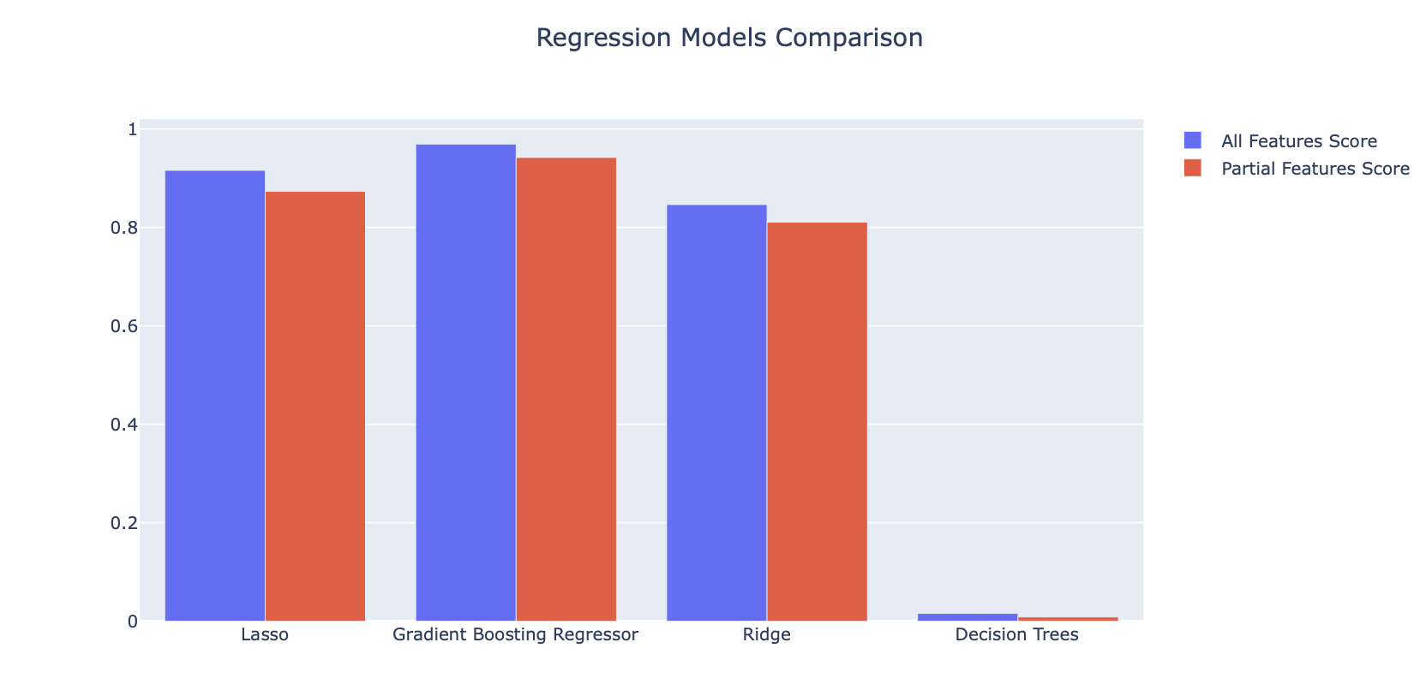
Models Comparison

Slide 16
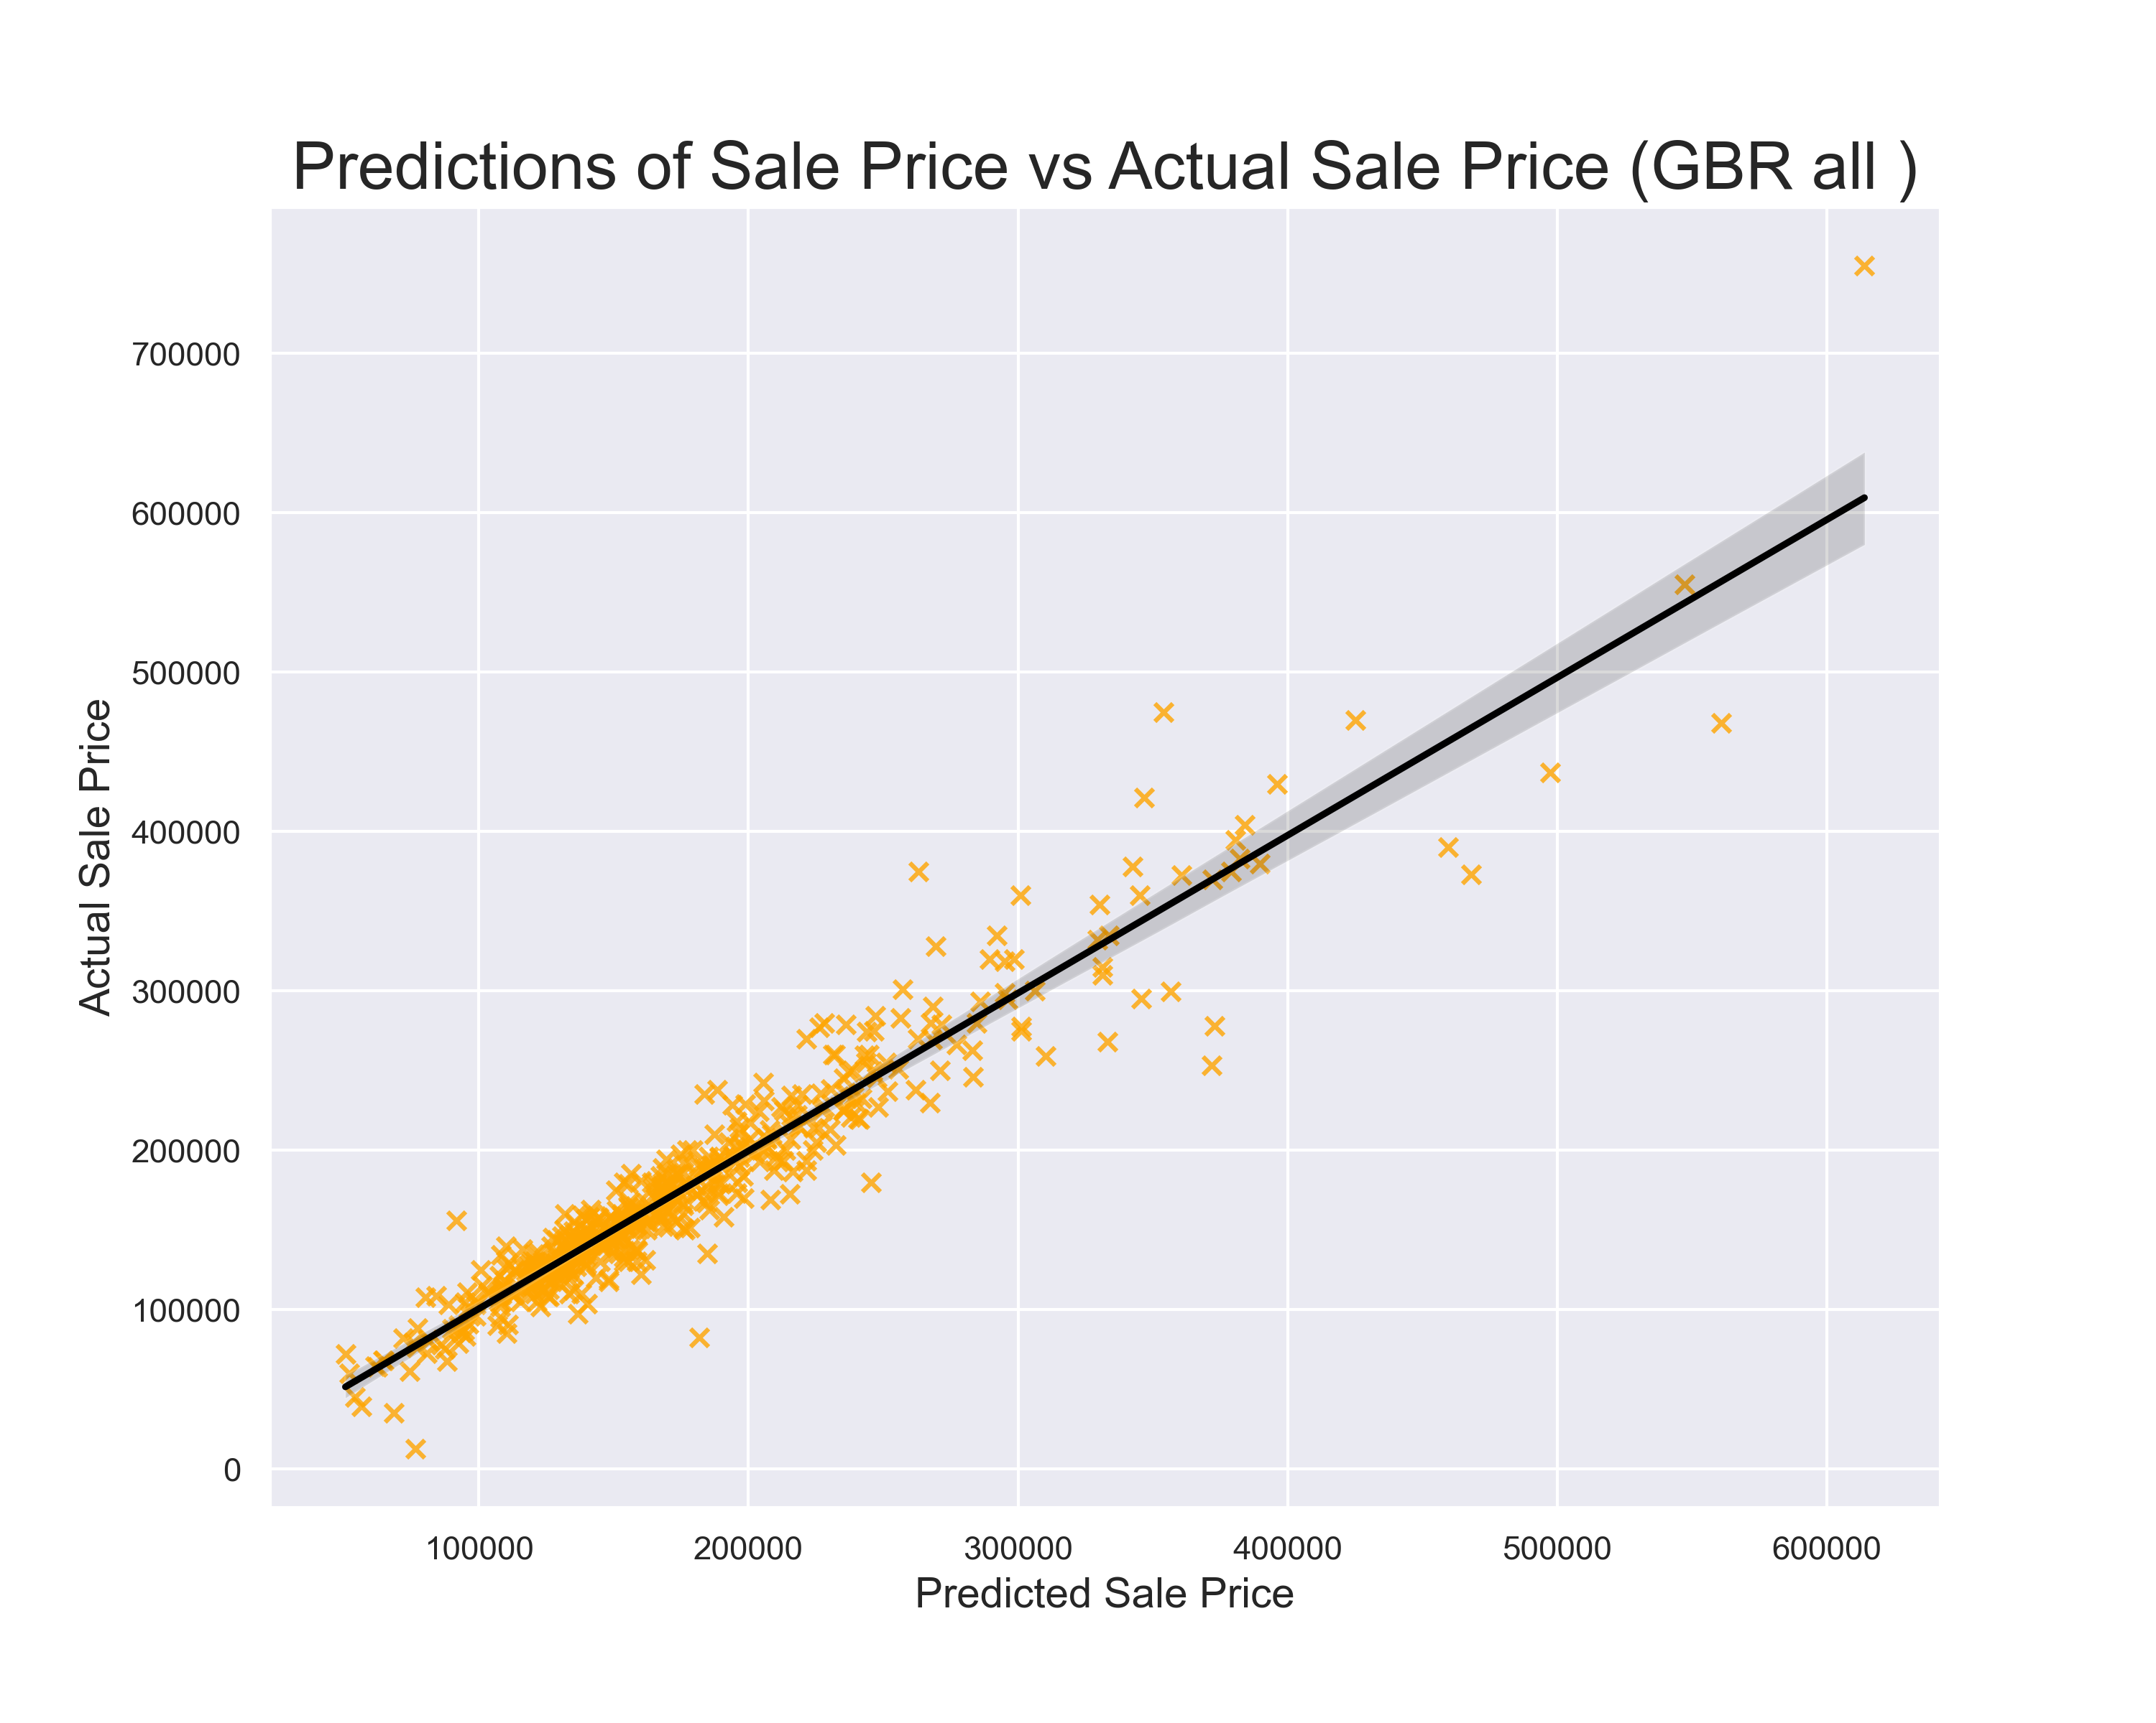
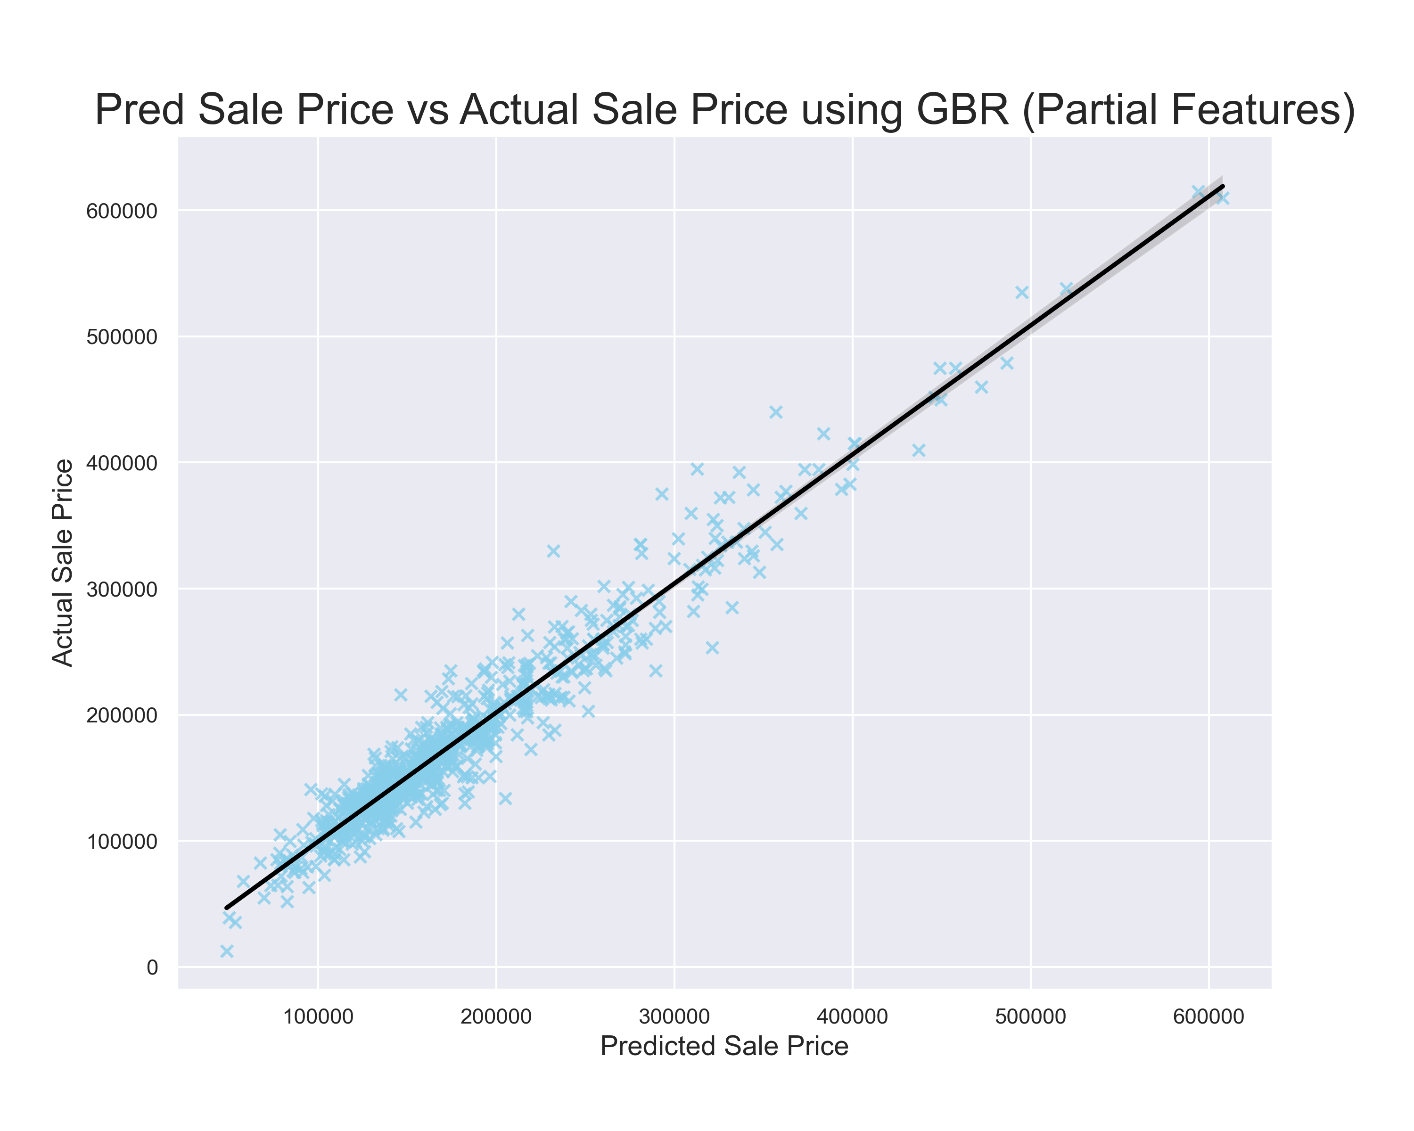
All Features VS Partial highly correlated

Slide 17
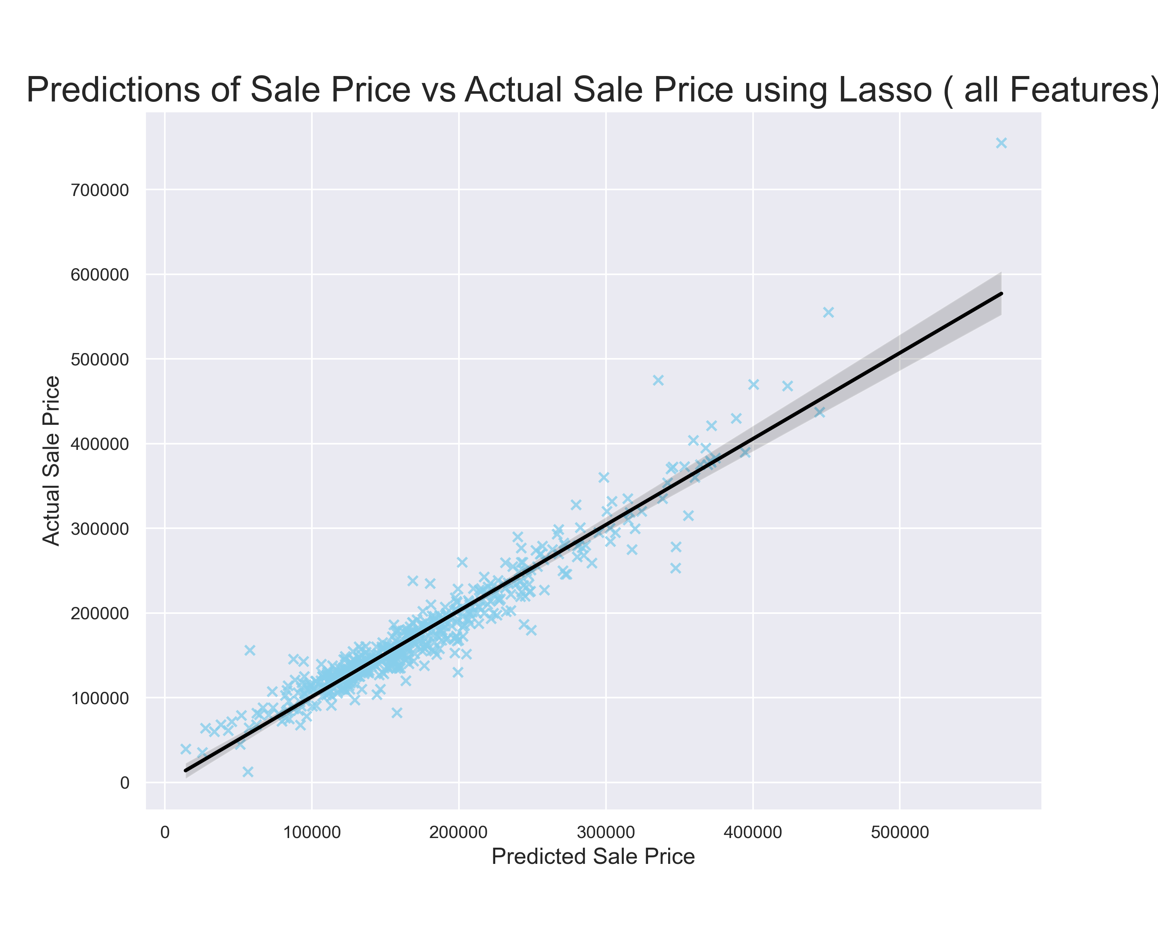
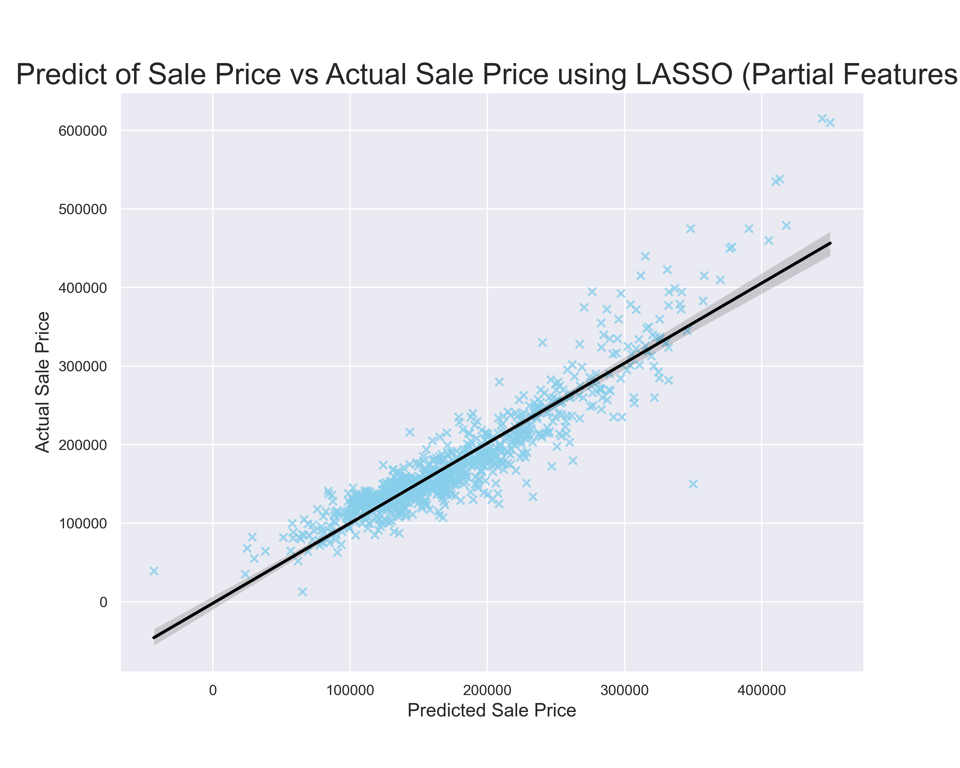
All Features VS Partial highly correlated

Slide 18
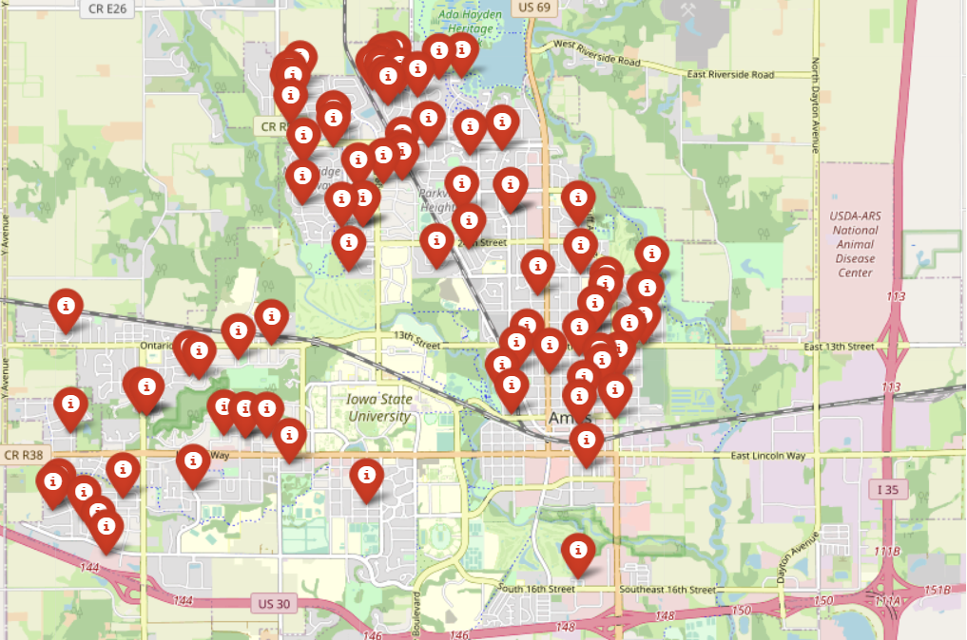
Geo Area of Ames

Slide 19
Future Work
Apply Different type of Modeling
Try to apply more Modeling to the data and check if its prediction accuracy is better
Enhance existing models
Try to filter the features used using the feature engineering methods to enhance the accuracy score.
Enhance mapping the data on the map
Tune and enhance mapping the locations to the map , by increasing the number of points on map and coloring them by price values .

Slide 20
THANK YOU

